Slide 1



Building a School Counselor Digital Workspace using Gemini Notebook
1

Slide 2
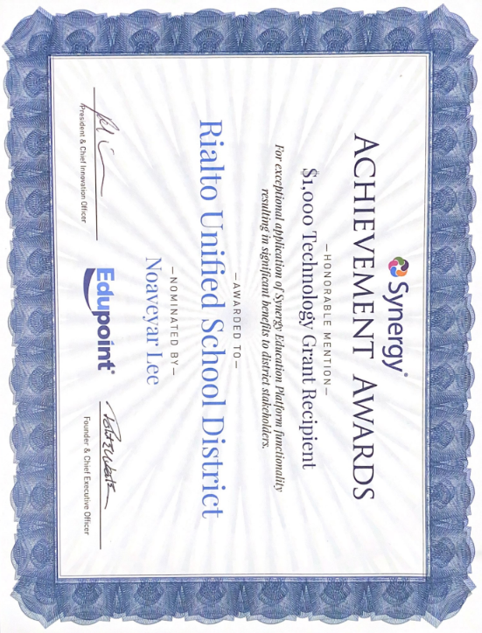



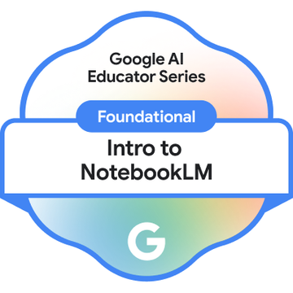
Noaveyar Lee, EdD, PPSC
Education Consultant
Notes:
Gen AI Regional Summit with student, teacher, business and community presenters

Slide 3

Welcoming Activity
What is one thing you’re hoping to learn today that would give you 30 minutes of your time back this week?
TYPE YOUR RESPONSE BUT
DO NOT
SEND THE MESSAGE UNTIL PROMPTED.
3

Slide 4
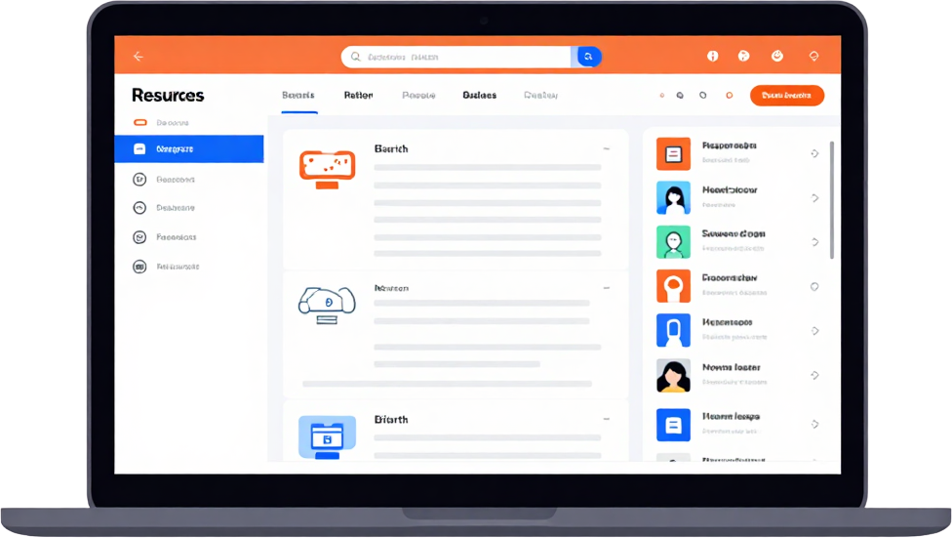

Learning Objectives
Learn the Artificial Intelligence platform Gemini Notebook Identify a Problem of Practice related to students, staff, and/or family/community engagement and design a targeted resource or solution using Gemini Notebook.
4

Slide 5
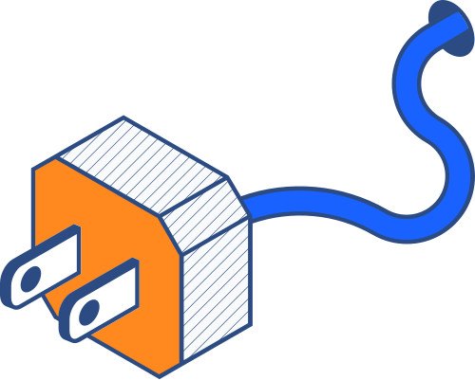
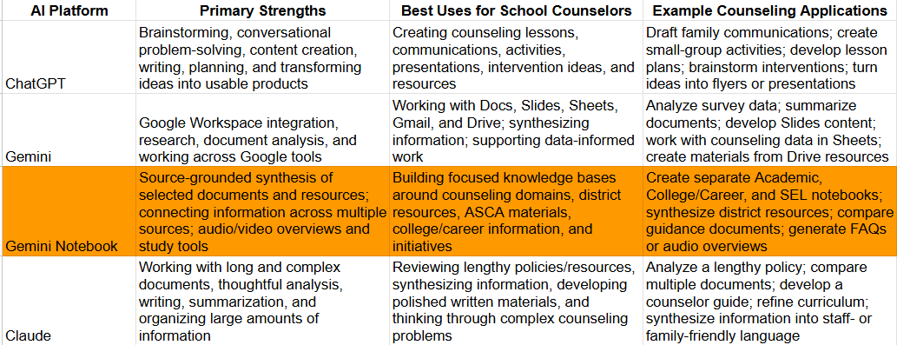

Artificial Intelligence Platforms
HTTPS://TINYURL.COM/DRLEEAIPLATFORMSSHEET
5

Slide 6
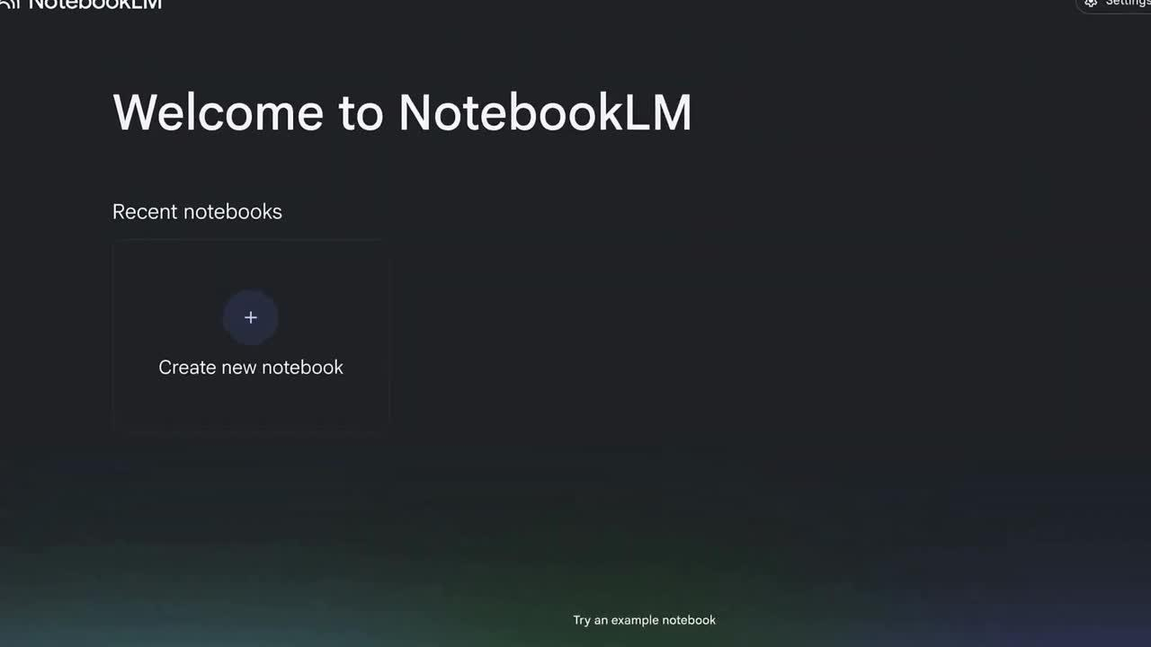
Gemini Notebook

Slide 7
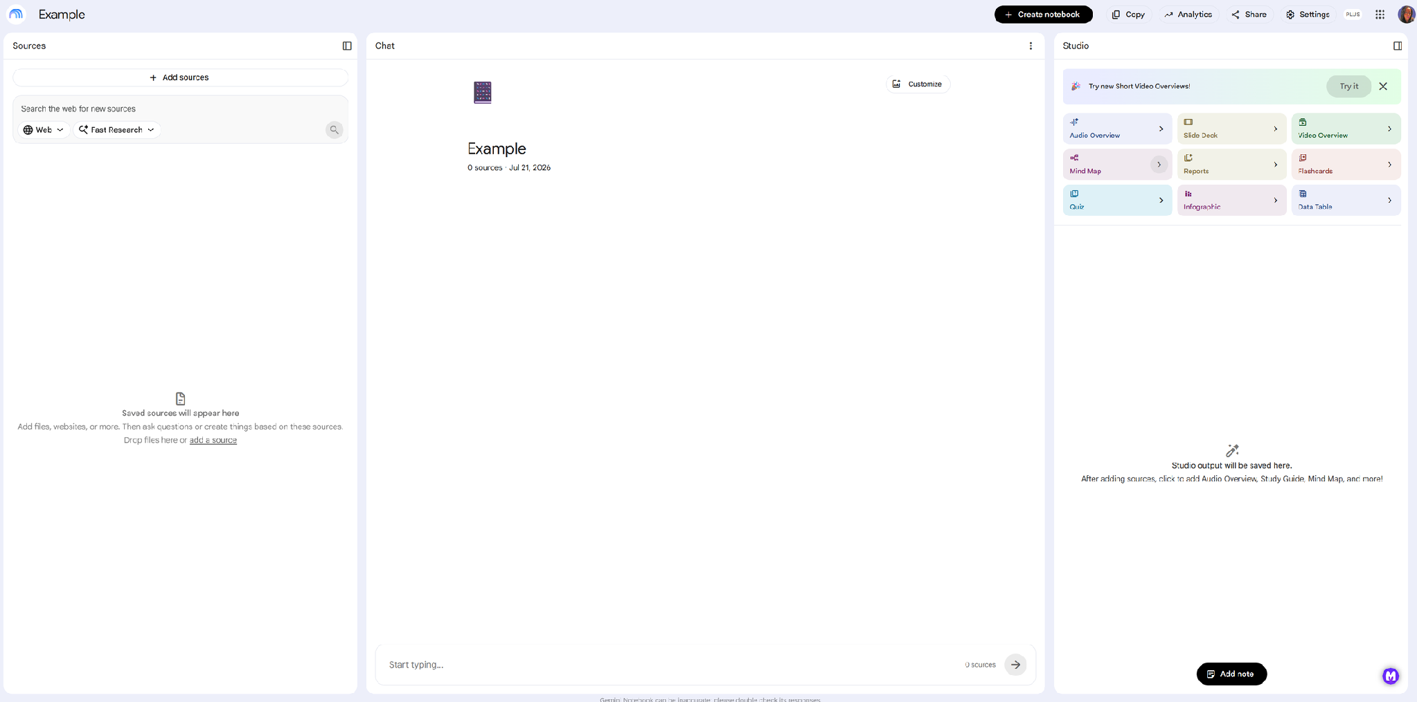
Gemini Notebook- notebooklm.google.com
Anatomy
Sources
Chat
Studio
7

Slide 8
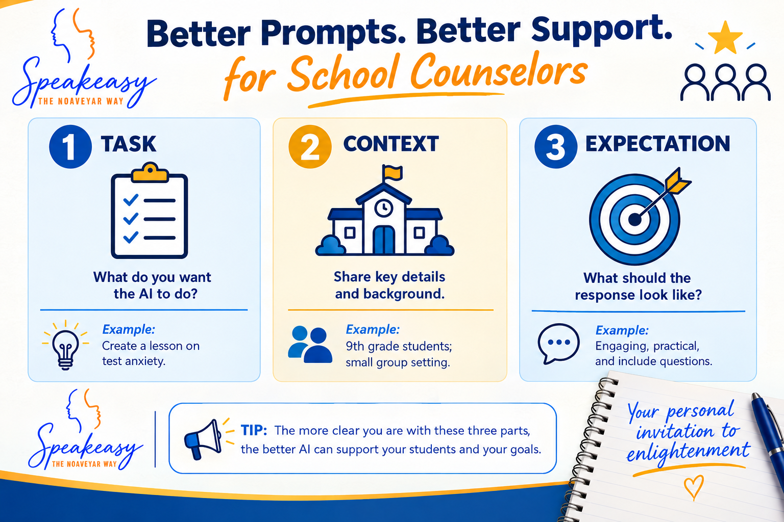
Creating AI prompts
Sample
8

Slide 9


Questions/Thoughts
9

Slide 10



Building a Notebook
Select which scenario we will input. Create a notebook to address the need. Open notebooklm.google.com.
An increase in Tier 2 chronic absenteeism among 7th graders following the first grading period, leading to course failure risks and graduation credit gaps.
Counselors challenged to stay under the 20% administrative paperwork threshold while managing student documentation, meeting summaries, and referral tracking.
Advising a middle or high school student who is undecided on college, interested in hands-on career technical programs (e.g., CTC), and needs a clear 4-year plan that meets diploma requirements.
10

Slide 11

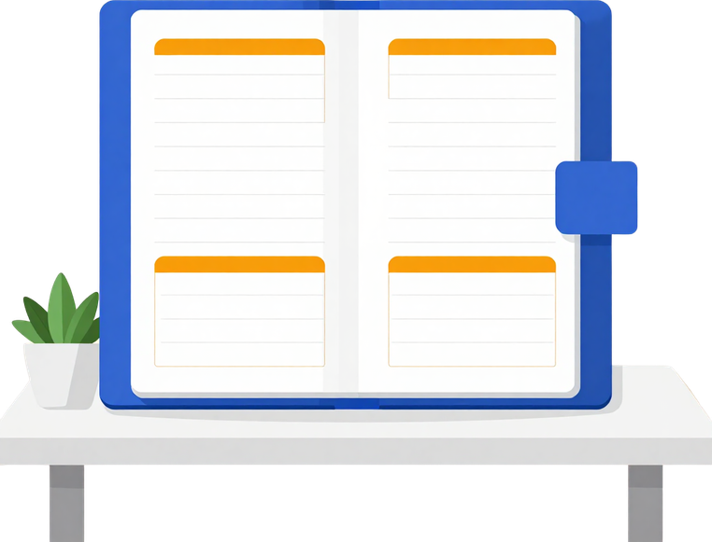




Gemini Notebook CCPS
Collaboration
In breakout rooms create a notebook by domain.
Add to Padlet
  Sources you included
  Studio feature(s) you used
  Prompts you asked in chat
  Edits/modifications you made
  Other
15
minutes
Identify
11

Slide 12

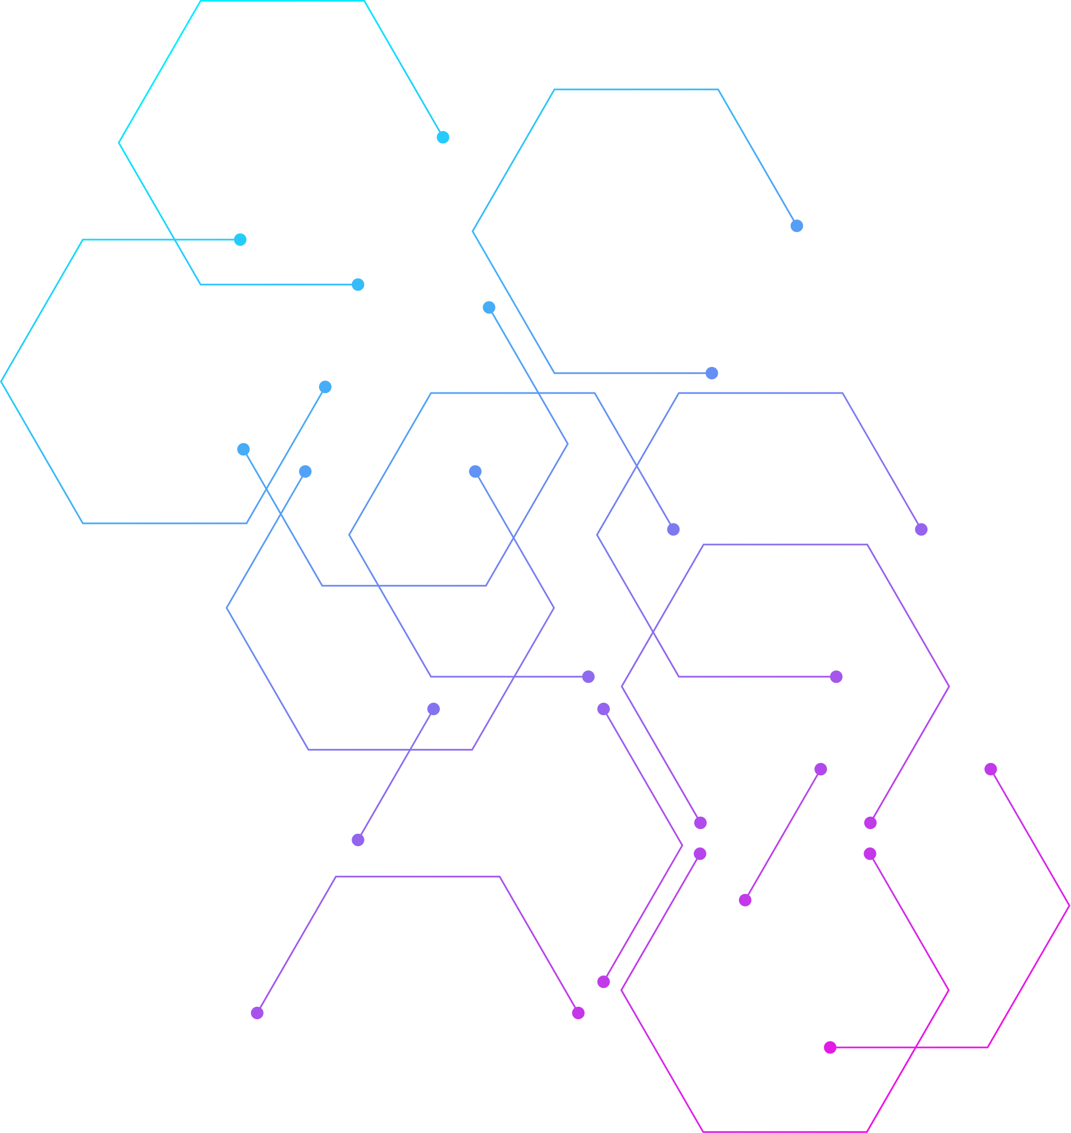
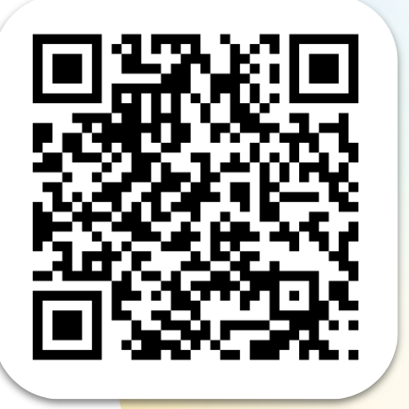
Google Educators
Ready to certify your skills?
Complete the short quiz that follows to demonstrate your understanding of these concepts and claim your Build just-in-time coaching badge.
Take the quiz
goo.gle/ges14
12

Slide 13
Closing Activity
WHAT HOMEWORK ASSIGNMENT WOULD GEMINI NOTEBOOK GIVE YOU? OPEN YOUR NOTEBOOK AND ASK "BASED ON THE SOURCES UPLOADED TODAY, GIVE ME 3 SPECIFIC ACTIONABLE WAYS I CAN USE THIS NOTEBOOK DURING MY WORK DAY TOMORROW."
13

Slide 14
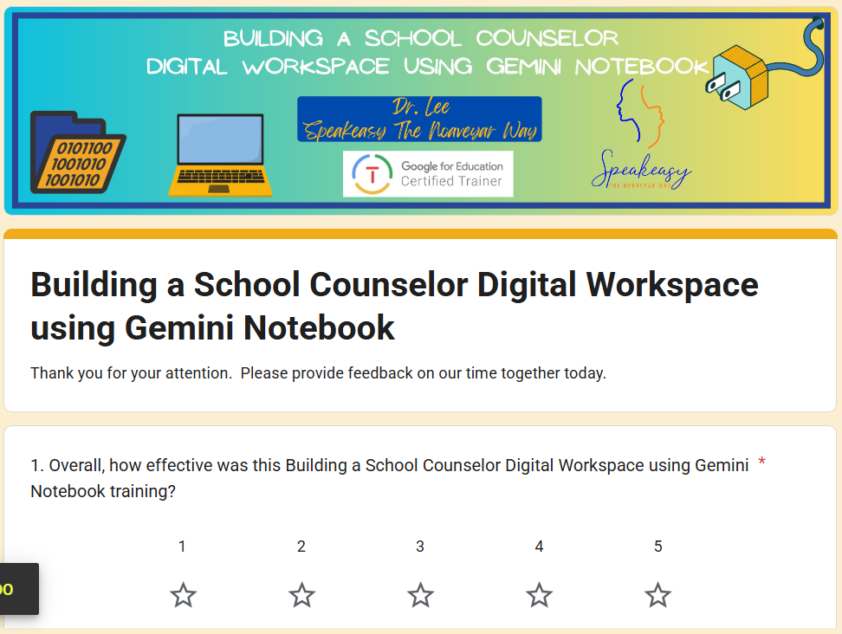

Feedback welcomed
https://tinyurl.com/DrLeeTrainingFeedback
14

Slide 15

Building a School Counselor Digital Workspace using Gemini Notebook
October 23, 2026
Instagram- @truleethedoctor
LinkedIn- Noaveyar Lee
Presented By :
Noaveyar Lee, EdD, PPSC

